Slide 1

Machine Learning for Pose Tracking using SLEAP
Maxwell Madden
Program in Neuroscience
University of Maryland School of Medicine

Slide 2
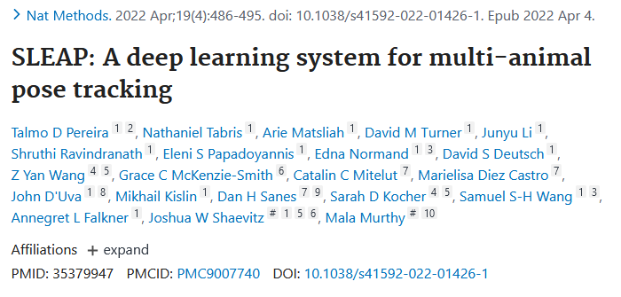
Resources
sleap.ai – SLEAP Documentation/Website
github.com/talmolab/sleap – SLEAP code/github repo
Misc Video Processing Tools
Handbrake – a GUI for ffmpeg transcoding
ffmpeg – transcoding video
opencv – python video analysis
Tips
Console Commands

Slide 3
Why SLEAP?
Open-source
Fast (around 5x the speed of DeepLabCut on equivalent datasets)
Requires smaller training sets for accurate pose-estimation
Highly configurable
SLEAP-Autoanalysis
Utility application for efficient ongoing analysis (cpu-inference)
Automatic transcoding prior to inference
Automatic framerate adjustment in cases of variable framerate or alignment with

Slide 4
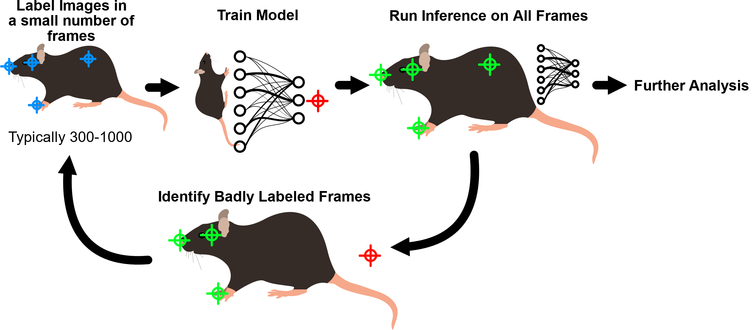
The SLEAP workflow

Slide 5
Preparing our environments
Determine what computer(s) we will use
Install Anaconda/Miniconda
Install SLEAP
Install AutoSLEAP (Optional, includes ffmpeg)
Consider using a computer with a NVIDIA GPU for faster training/inference
Anaconda.com
conda create -y -n sleap -c conda-forge -c nvidia -c sleap -c anaconda sleap
conda create –y –n sleap-autoanalysis –c mxwllmadden –c conda-forge sleap-autoanalysis

Slide 6
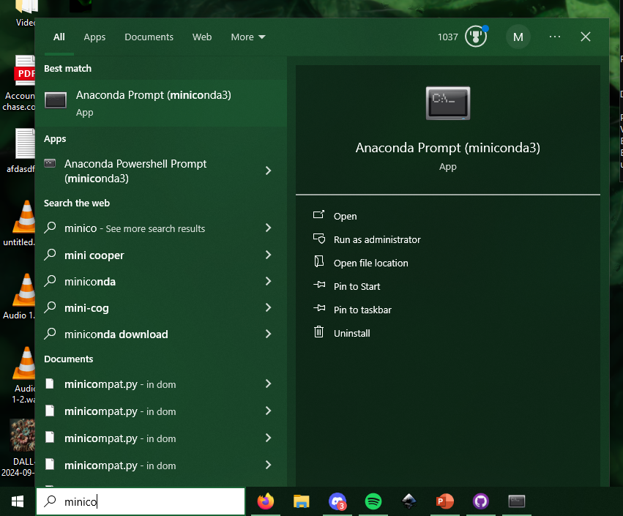

Slide 7
conda create -y -n sleap -c conda-forge -c nvidia -c sleap -c anaconda sleap
conda create –y –n sleap-autoanalysis –c mxwllmadden –c conda-forge sleap-autoanalysis
(Optional)

Slide 8

Transcode video for input to SLEAP…
SLEAP currently supports .mp4 or .avi
…via ffmpeg
…via the Autoanalysis Wizard
…via handbrake
(SLEAP-Autoanalysis) C:\Users\user> ffmpeg -y -i input.video -filter:v "fps=fps=30"
-c:v libx264 -pix_fmt yuv420p -preset superfast -crf 23 output.mp4
(SLEAP-Autoanalysis) C:\Users\user> autosleap wizard
www.handbrake.fr
Occasionally video will be unplayable
due to corrupted headers/minor issues
This can sometimes be fixed by the
Transcoding process
Keep in mind that transcoding ALWAYS
results in quality loss. NEVER discard the original file.

Slide 9
Label Images (Demo)

Slide 10
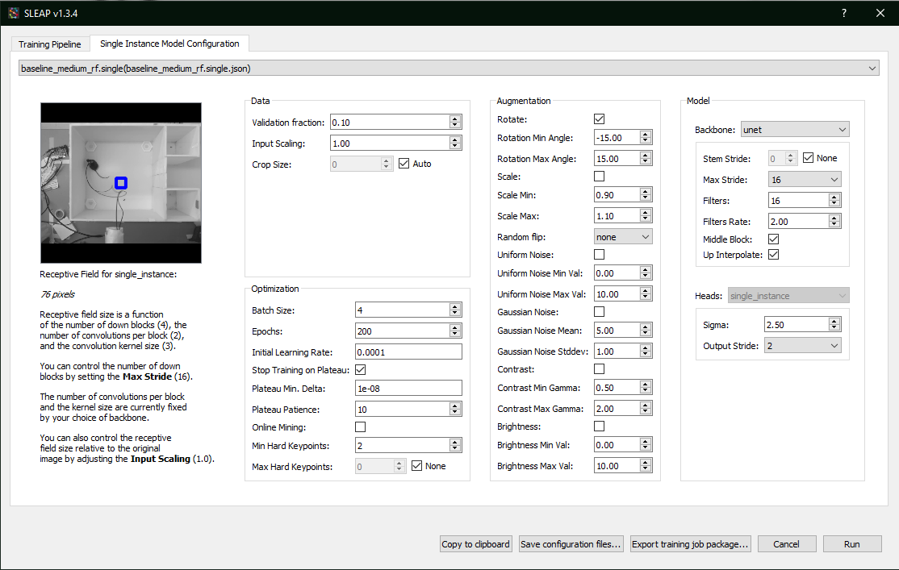
Choose Hyperparameters
Feel free to experiment! Different
hyperparmaters may lead to better
performing models depending on
recording conditions/experiment etc

Slide 11
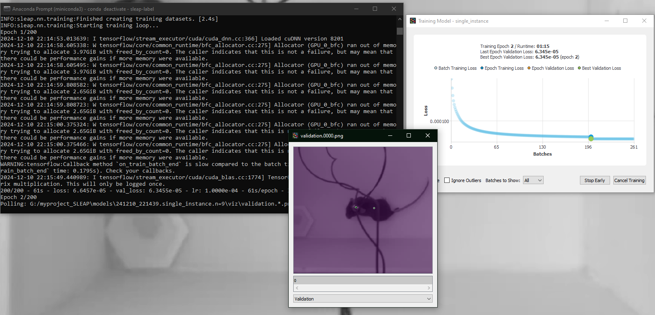

Slide 12
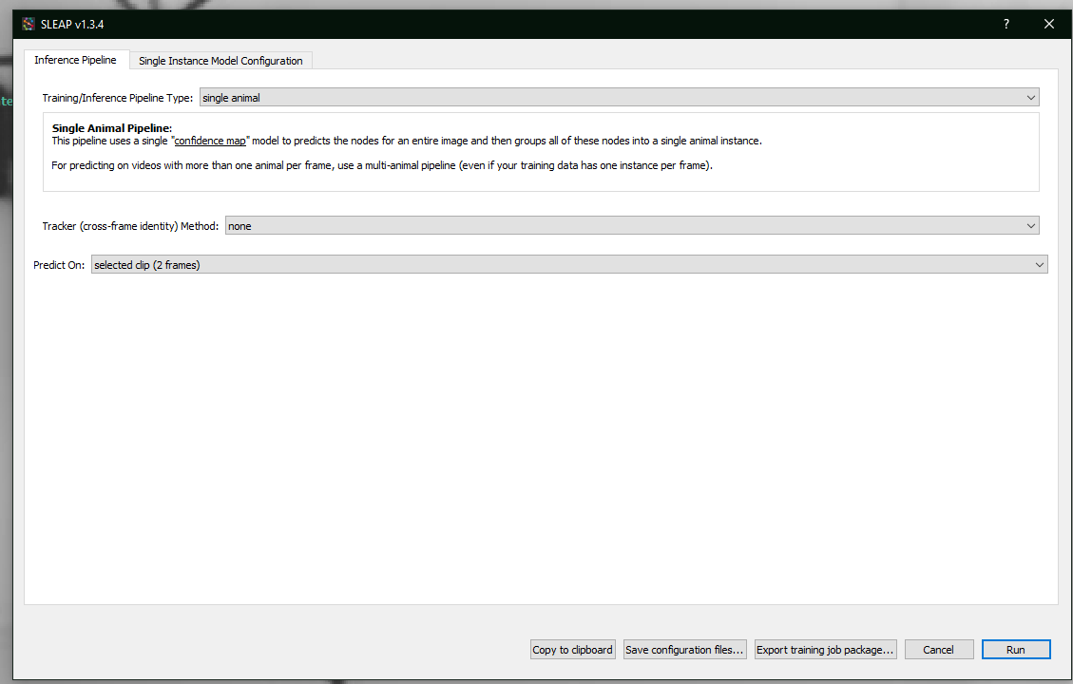
Run SLEAP Training

Slide 13
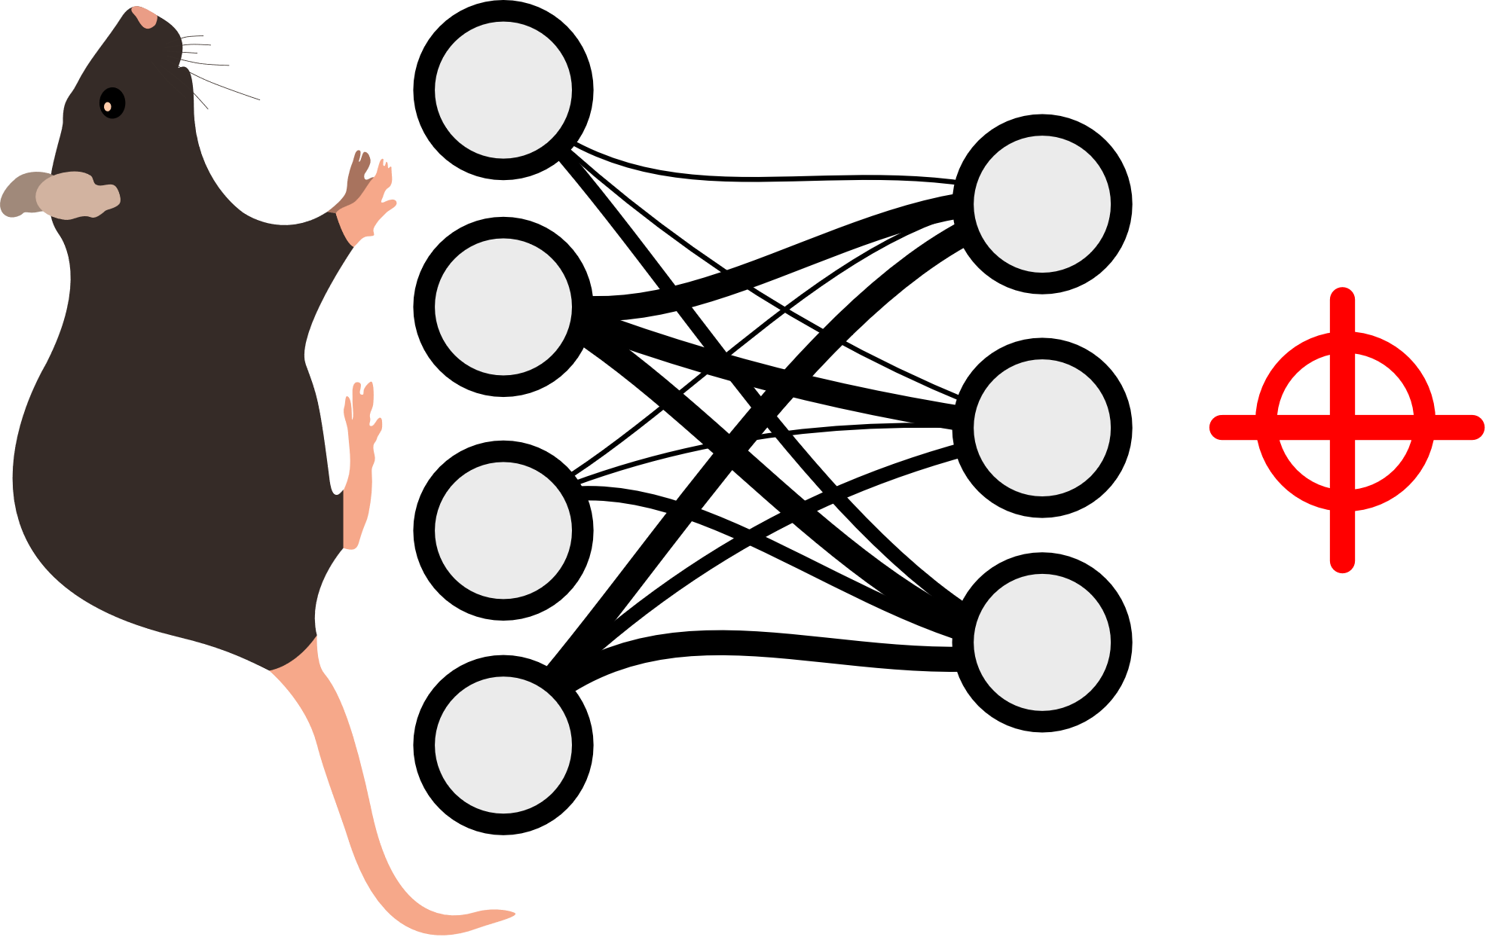
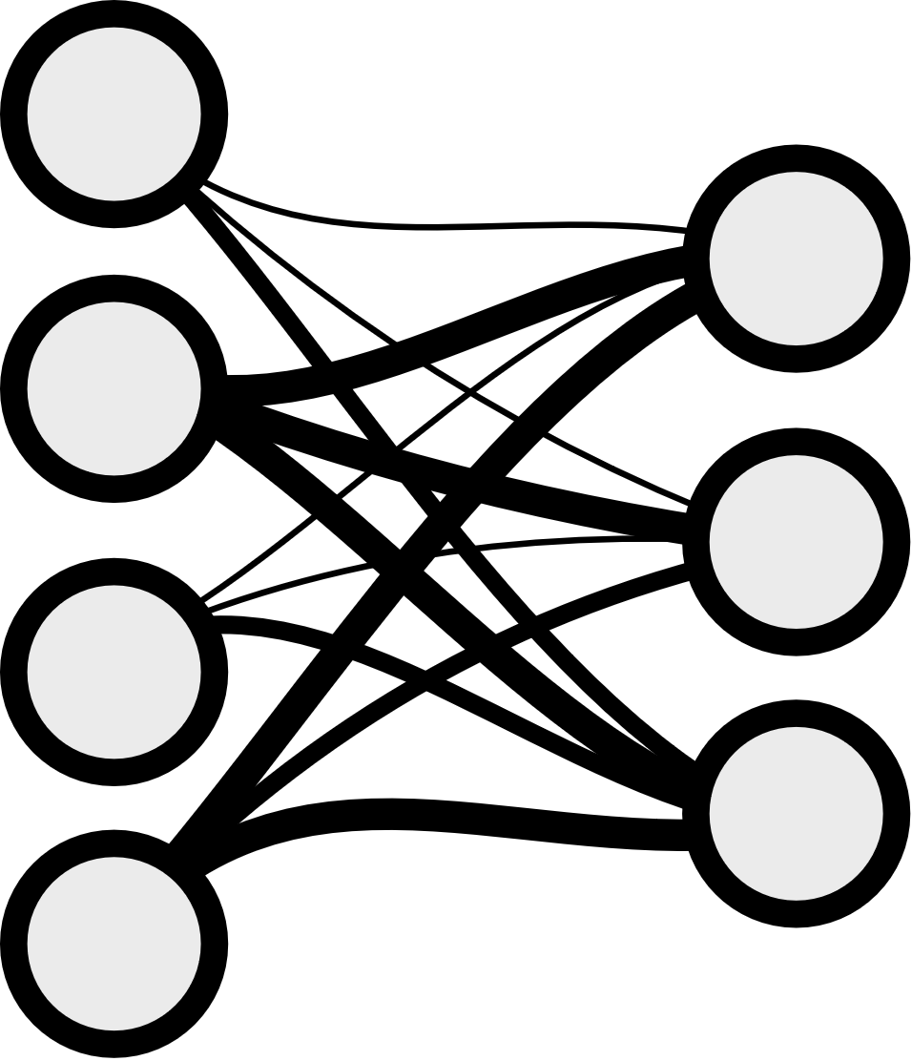

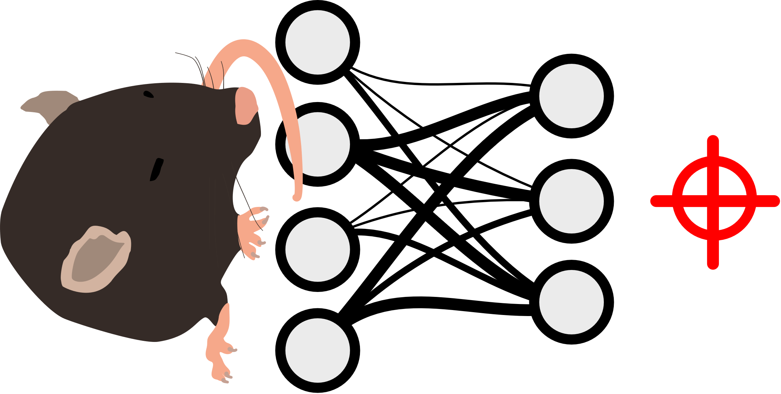
What is happening?
Learning Rate
Learning
Algorithm
Calculate Loss
Batch size
Larger batch size increases training speed
at the cost of potentially reduced model
performance (overfitting)
Batchsize = 2

Slide 14
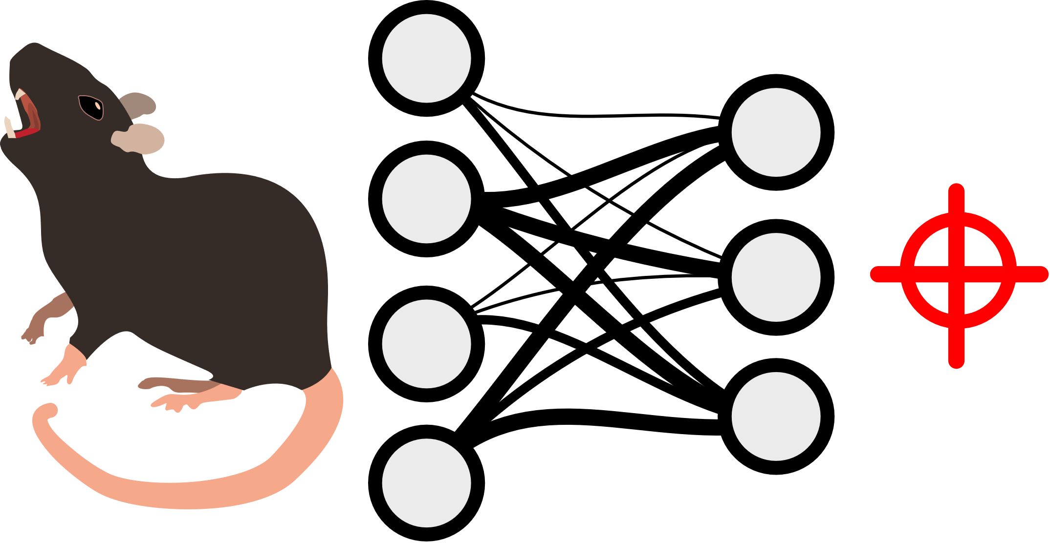
What is happening?
Epoch
Validation

Slide 16
(Identify badly labeled frames)

Slide 17
Run SLEAP Training again…
…and repeat until you have reliable tracking
You now have a model that can robustly track an animal in your behavioral arena/experiment
sleap-track input.mp4 –m training_config.json" --tracking.tracker none -o
output.predictions.slp --verbosity json --no-empty-frames
sleap-convert --format analysis -o output.h5 input.predictions.slp
Models are only good at predicting pose
in situations they have been trained on…
Train a new model when
Camera position changes
Arena/experiment changes

Slide 18
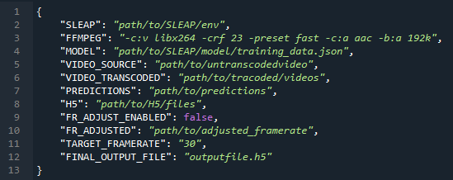
Setup SLEAP-Autoanalysis
Most useful when running experiments over long periods on restricted hardware (cpu).
(SLEAP-Autoanalysis) C:\Users\user> autosleap new –f my_project
(SLEAP-Autoanalysis) C:\Users\user> autosleap run –f my_project

Slide 19
SLEAP-Autoanalysis Settings

Slide 20
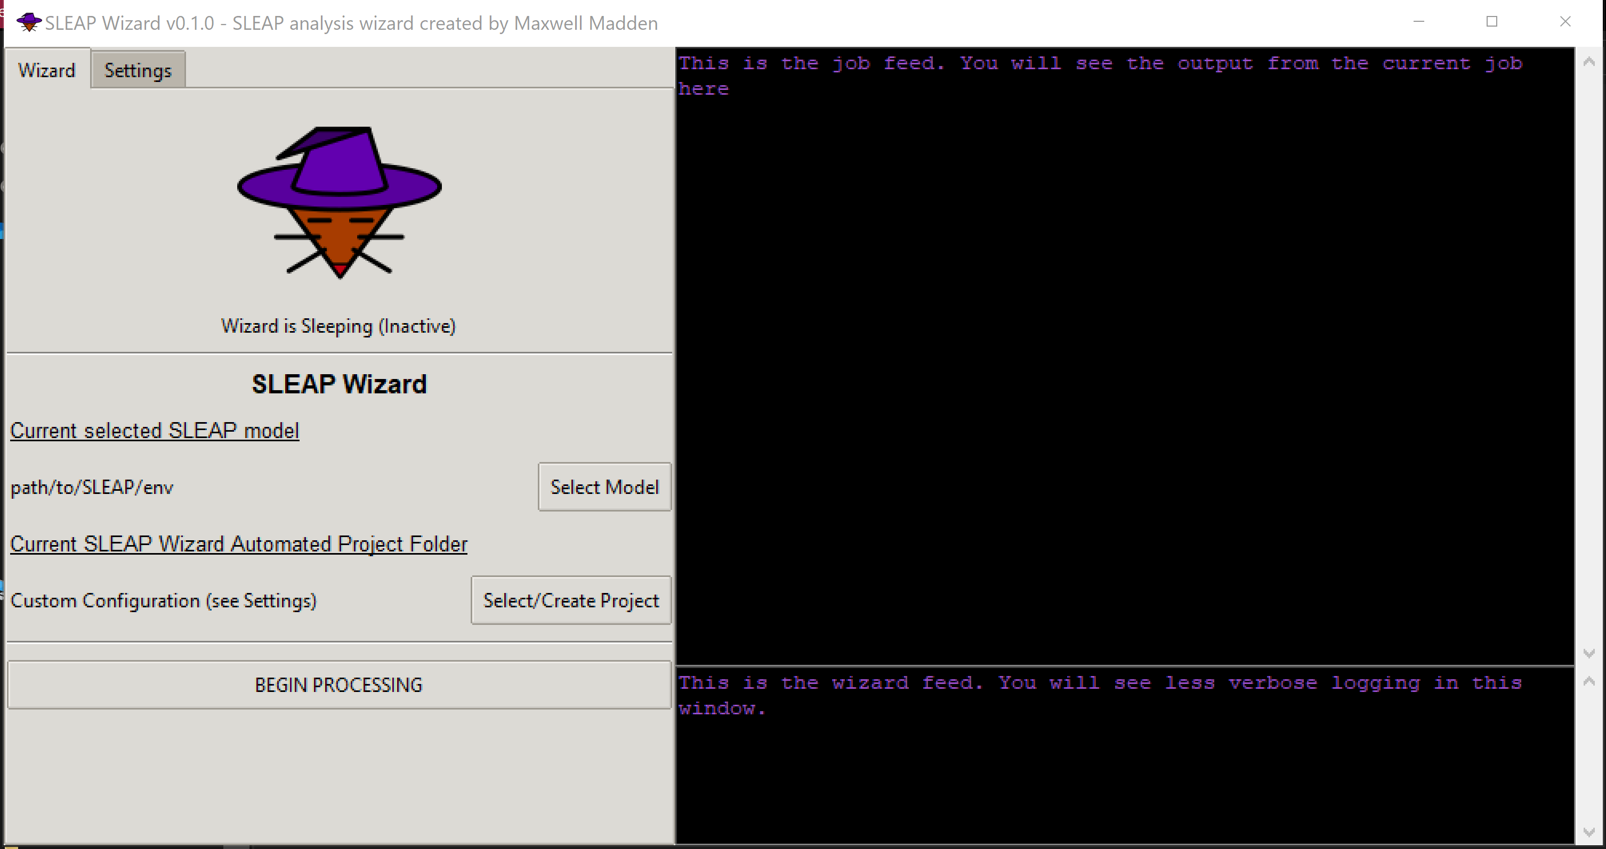
Alternative: the Wizard
(SLEAP-Autoanalysis) C:\Users\user> autosleap wizard

Slide 21

Framerate adjustment
1 Second
File info:
Constant framerate
6 Hz
Trajectory Output:
Looks like we recorded
over 1.5 seconds of
movement!!!
Framerate in video is not guaranteed to be constant…

Slide 22
Framerate adjustment
1 Second
File info:
Constant framerate
6 Hz
Framerate adjusted for more accurate labeling!

Slide 23
Opening and using the final output
In python
In MATLAB
import h5py
with h5py.File(filename, ‘r’) as file:
data = file[‘dataset’]
H5disp(filename);
data = h5read(filename, ‘dataset’);

Slide 24
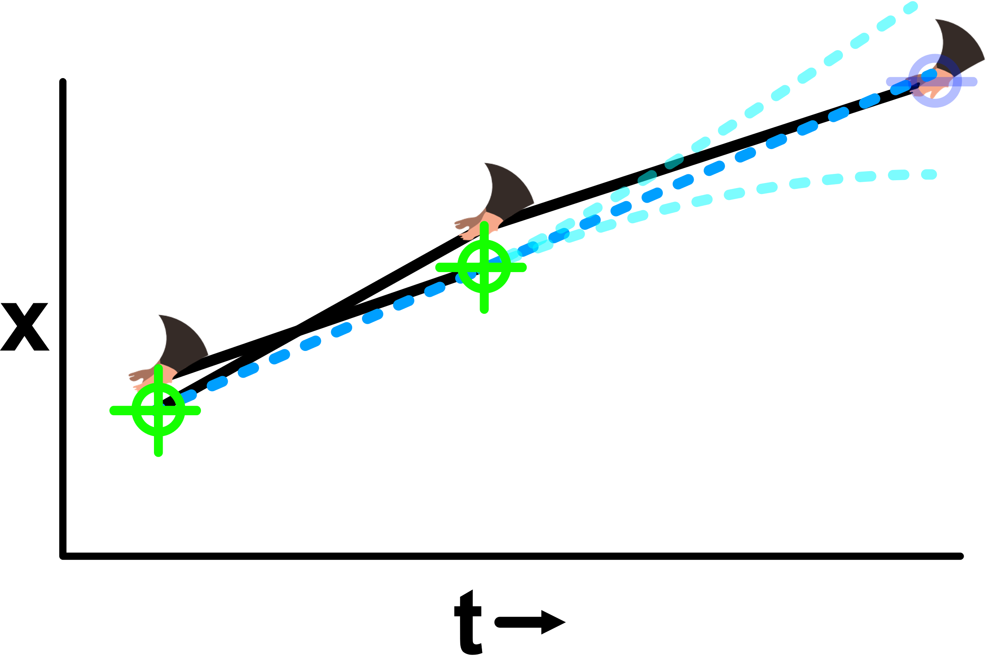
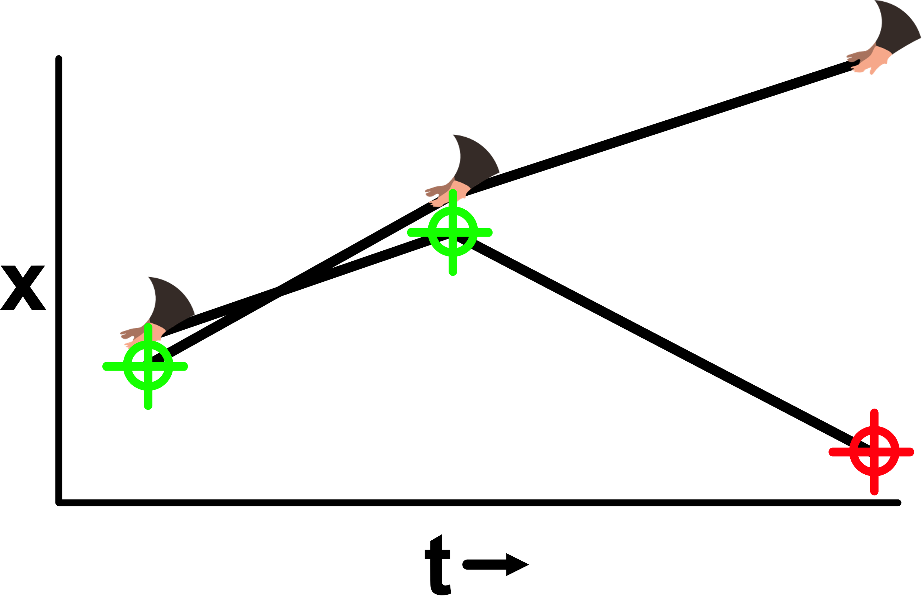
Labeling multiple, similar bodyparts
For difficult tracking tasks use of a Kalman filter can reduce errors (talk to steffan, likely requires high frame rate)

Slide 25


Other capabilities of SLEAP
Labeling of multiple animals in the same arena
Tracking of skeletons, objects in arena
3d pose estimation via SLEAP-Anipose
github.com/talmolab/sleap-anipose

Slide 26
Visualization
ALWAYS VISUALIZE YOUR DATA
Tracking Visualization is available in the SLEAP GUI
As well as in the autosleap.visualize module
import autosleap as asl
asl.visualize.label_video(
videofile.mp4,
trajectories.mp4, # non-adjusted
outputfile.mp4)

Slide 27
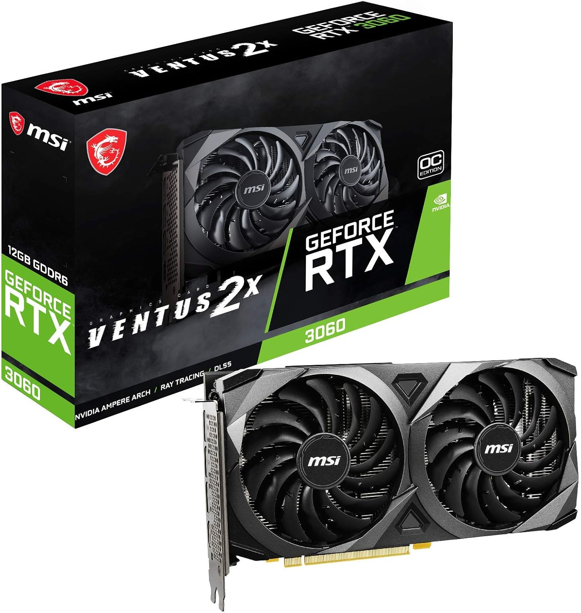
Leveraging more powerful hardware
GPUs perform machine learning tasks at high speed.
Install the latest GPU driver from the
manufacturer website BEFORE setting
everything up
GPUs MUST be NVIDIA and have CUDA
support for use with SLEAP
Larger VRAM enables use of higher
resolution video or a larger batch size
hyperparameter
Intel i5-12600K: 4 fr/sec
RTX GeForce 3070: 40 fr/sec
RTX GeForce 3060 currently offers 12GB VRAM for $300

